Slide 1

COMPUTER NETWORKING
TOPIC:IMPLEMENTATION OF SMOKE DETECTION AND FIRE SAFETY SYSTEM USING CISCO PACKET TRACER
Team Members:
Sriharsha Itha (RA1911003010225) Hitesh Pande (RA1911003010233) Sajal Tyagi (RA1911003010238) Vishal Dwivedi (RA1911003010243)

Slide 2
INTRODUCTION
Internet of Things is a burgeoning field in the world of technology
It helps ease life for a person by means of internetworking physical devices, home appliances and other items embedded with electronics, software, sensors and actuators.
Smoke detection and fire safety system is a system that helps minimise damages from fire.

Slide 3
INTRODUCTION
Smoke detection and fire safety system controls objects such as windows, doors, warning lights, and also few smoke detectors, and alarm using IoT technology.
In this project we are implementing smart smoke detection and fires safety system with IoT and we will show the implementation of this system using Cisco Packet Tracer.

Slide 4
REQUIREMENT ANALYSIS
Our Smoke detection and fire prevention project was implemented on Cisco- packet tracer for testing. Components used for our project are as follows:
• Home Gateway
• Door
• Smoke Detector
• Fire Sprinkler
• Siren
• Garage Door
• Smartphone
• Window

Slide 5
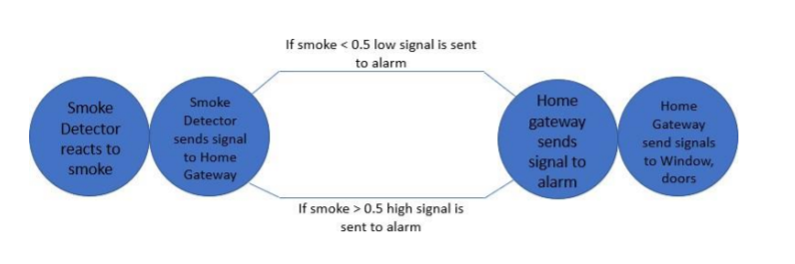
ARCHITECTURE DIAGRAM

Slide 6
METHODOLOGY
To Implement Smoke Detection System, we will be using cisco packet tracer, which includes different smart objects used for home automation such as smart door, smart window, different sensor, etc.
Different Types of conditions are written on to the smart devices based on the user requirement to control the home and fire safety is assured to user.

Slide 7
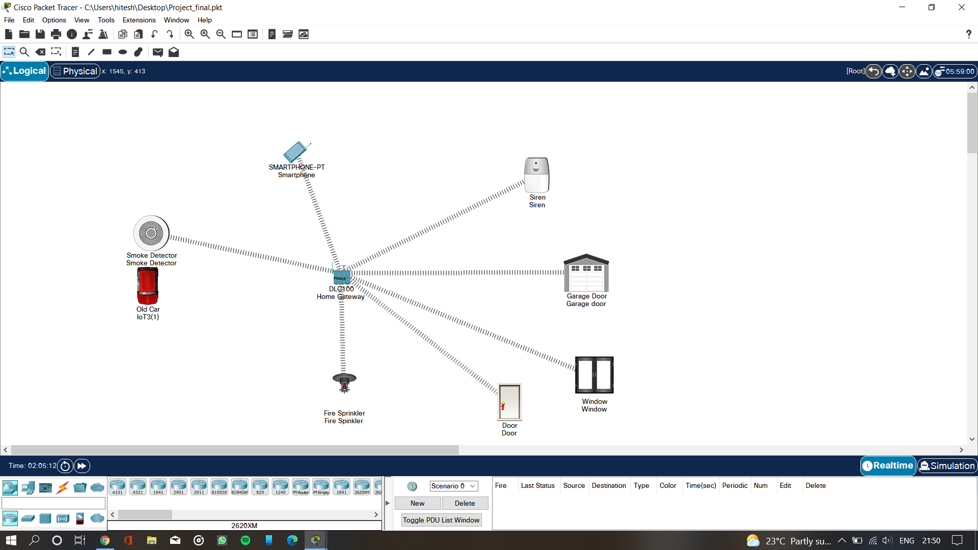
METHODOLOGY
This is the implementation that we have done which shows the smart devices are connected to the home gateway and smartphone using wireless medium to manage smart devices remotely.
Before accessing the smart devices we have to connect them to the home gateway.
After registering smart devices to home gateway, all devices can be accessed through web by smartphone.

Slide 8
EXPECTED RESULTS
When excess smoke is detected by the smoke sensor, the following activities are expected to take place :-
Sounding of alarm and flashing of beacon from the smart siren.
Starting of water spray from the fire sprinkler should happen.
Smart window should be opened automatically, garage door should also be opened.
Smart door should be unlocked immediately.

Slide 9
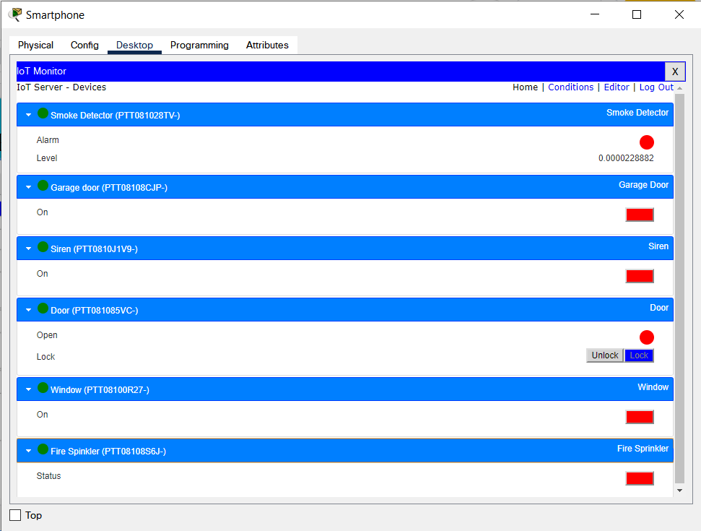
EXPECTED RESULTS

Slide 10
THANK YOU

